Slide 1
TYPE HERE

Slide 2
Type here
Type here
Type here
Type here
Type here

Slide 4
Teacher Troubleshooting Notes:
If the background images aren’t showing up when printed…
Make sure you save the finished PowerPoint file as a PDF, then open the PDF and print from there.
Make sure you aren’t inadvertently “hiding background graphics.” Go to the “Design” tab, then “Format Background,” and ensure the “Hide Background Graphics” option is NOT selected.
You could also try saving the slides as JPEG images. To do so:
Have the desired slide selected.
Go to File > Save As
Change the file type to “jpeg”, save
On the “Home” tab, add a “new slide”
On the “Insert” tab, go to “pictures” and insert the jpeg you just saved.
Print the new slide.
OR… use the following two slides instead.
The following two slides appear to be the exact same as the first two slides. HOWEVER, there is a slight difference: the images have NOT been set as the background. Instead, they are jpeg images inserted onto the slides. If you’re having trouble with the first two slides printing correctly, you can try using the following two slides. The downside of using the following two slides is that the images are moveable: so students can inadvertently move the images and therefore not have them be aligned properly.

Slide 5
TYPE HERE

Slide 6
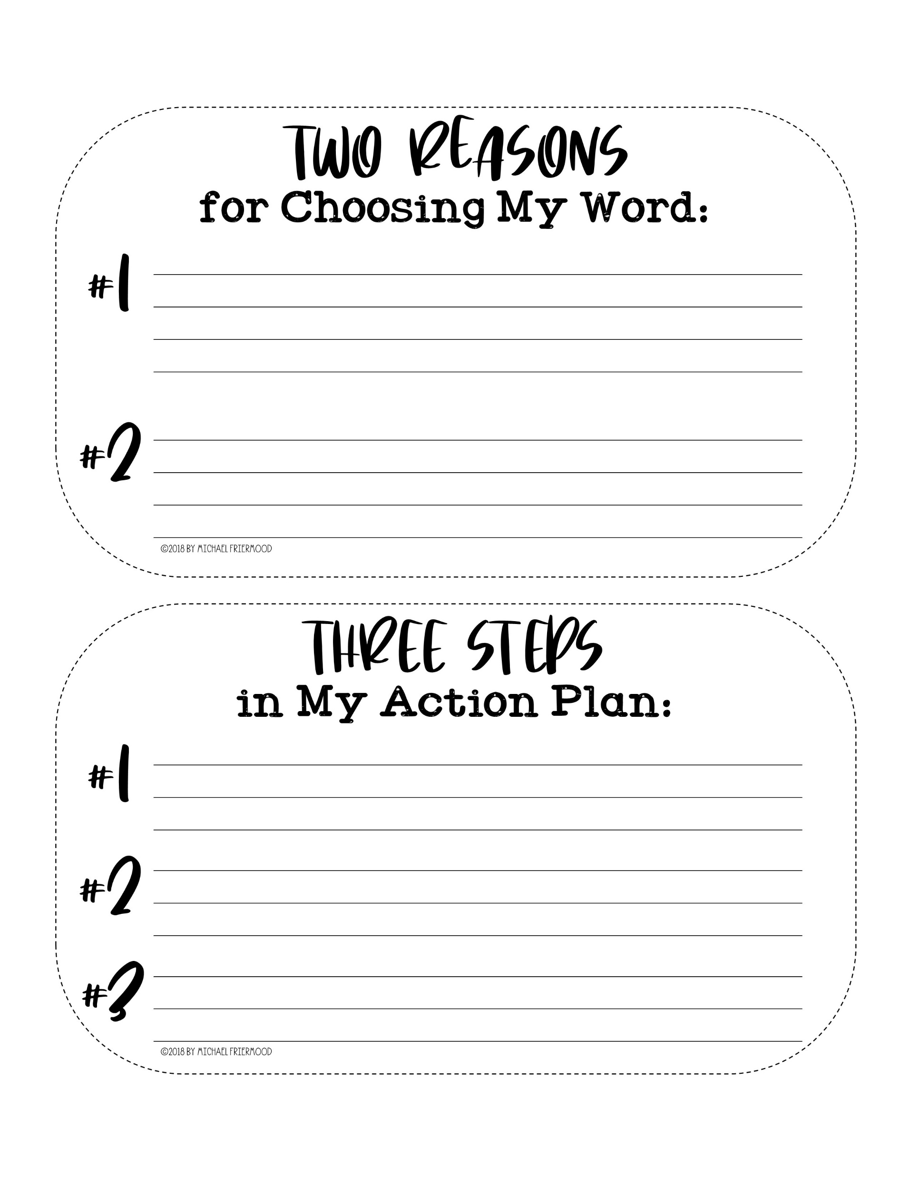
Type here
Type here
Type here
Type here
Type here

